Slide 1
Chapter 6: Einstein’s special relativity
Frames of reference
Notes:
Newton’s laws served, and continue to serve, as a useful way of understanding motion. But when things start to move really fast, adjustments need to be made.
Observations are intricately connected to the speed of light. Understanding of light developed after the work of Maxwell, who unified electricity and magnetism.
Einstein’s deep thinking about electromagnetism and its relationship to observations of moving things led him to reconsider the assumptions we make about relative motion. Assumptions about time and space were found wanting. Far from being absolute quantities that were the same in all reference frames, Einstein showed that time and space measurements are always made relative to the observer and with the limits of the speed of light in mind.

Slide 2

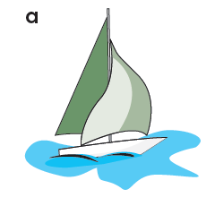
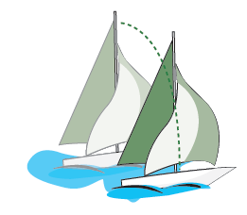
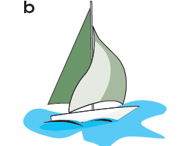
Galileo’s thought experiment
Paths of objects depend on the frame of reference
Object falls:
Straight down
On board ship
Object falls:
Curved path
From shore
Notes:
Classical mechanics – Galilean and Newtonian – takes a ‘commonsense’ view of the world. In this instance, different observers see the fall of an object differently, because they are at different observation points. A sailor sees the object fall straight down. A person on shore sees the object describe a curved path.
In classical mechanics, it is assumed that the difference between the observations of the two paths can be explained by assuming time and space to be the same for both observers.

Slide 3
Inertial frame of reference
Newton’s first law
an object at rest remains at rest
an object travelling at constant velocity
continues at that velocity
Inertial frame of reference
Newton’s first law applies:
to a good approximation
departures from the law are negligible
Notes:
An inertial frame of reference is one in which Newton’s laws apply within acceptable limit.

Slide 4
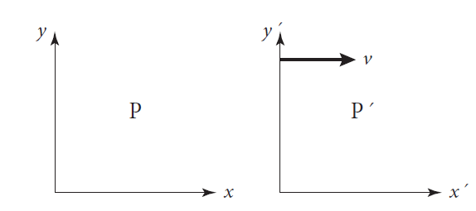
Galilean transformations
Inertial frames are equivalent
If P is stationary and P/ moves at velocity, v, assume:
Distance intervals are the same
Time intervals are the same
Notes:
An object has coordinates in two reference frames. P is assumed stationary and P/ is moving to the right at speed, v. If you assume that distance and time intervals are the same in both frames of reference, the coordinates can be reconciled. In two dimensions, the coordinates of an object travelling with velocity components, vsubx and vsuby, can be reconciled

Slide 5
Principles of classical relativity
Relativity principle (Galileo/Newton)
In different frames you get different values for:
Acceleration
Energy
Momentum
BUT
In all inertial frames
Laws of motion are the same
Newton 1 … Newton 2 … Newton 3
Conservation laws:
energy
momentum
All inertial frames are:
Equivalent
Equally valid
Notes:
Since speed and acceleration depend on space and time coordinates, acceleration, energy and momentum will have different values in different reference frames. However, Newton’s laws, the Law of Conservation of Energy and the Law of Conservation of Momentum, will be the same in any reference frame.
Thus, all inertial frames are equivalent, that is, equally valid. There is no privileged reference frame.

Slide 6
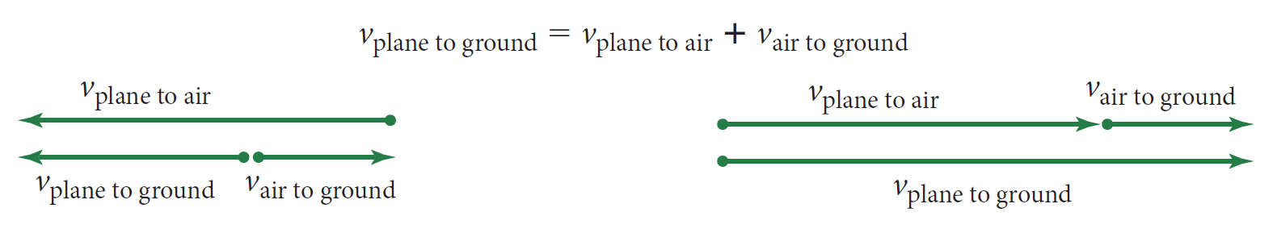
Relative velocity in inertial frames
Notes:
For an aeroplane, three reference frames can be identified: the plane (A), the ground (B) and the air (C). The velocity of the plane relative to the ground (vsubAB) is a combination of the velocity of the plane relative to the air (vsubAC) and the velocity of the air relative to the ground (vsubAC). The resultant is a geometric vector addition.

Slide 7
Chapter 6: Einstein’s special relativity
Problems with classical relativity
Notes:
Maxwell’s integration of electricity with magnetism had a surprising effect on the study of motion. The speed of light was shown to be dependent only on the properties of a material (permeability and permittivity – see Chapter 5).
It did not depend on the source or the frame of reference in which it was viewed. Experiments were conducted to find the medium that allowed light to travel as a wave in a vacuum and to see whether the speed of light really was independent of the reference frame.

Slide 8
Challenge from Maxwell
Maxwell synthesised electricity and magnetism
Light acts as an electromagnetic wave:
Speed of light depends on a material’s:
permeability:
permittivity:
depends on the medium
does NOT depend on the source
does NOT depend on the relative motion of the medium or the observer
Notes:
Maxwell showed that light acts as a self-sustaining electromagnetic wave whose speed depends only on the magnetic and electrical properties of the medium – permeability and permittivity respectively.
The speed of light does not depend either on the source or the observer.

Slide 9
Aether
Do electromagnetic waves vibrate aether?
transparent
weightless
fixed in space
Earth and Sun move relative to aether
Prediction
Speed of light in aether:
Speed of light relative to aether:
If … the prediction is confirmed
Then … motion and electromagnetism both conform
to classical relativity
Notes:
By analogy with sound, light waves need a medium in which to propagate. This medium was called the ‘luminiferous aether’. It was transparent, weightless and fixed in space. Celestial bodies, notably the Sun and Earth, moved relative to the aether. Experiments were devised to find evidence for the aether’s existence. If Earth was moving relative to the aether, then the speed of light relative to the aether should be predictably different from ‘c’.

Slide 10
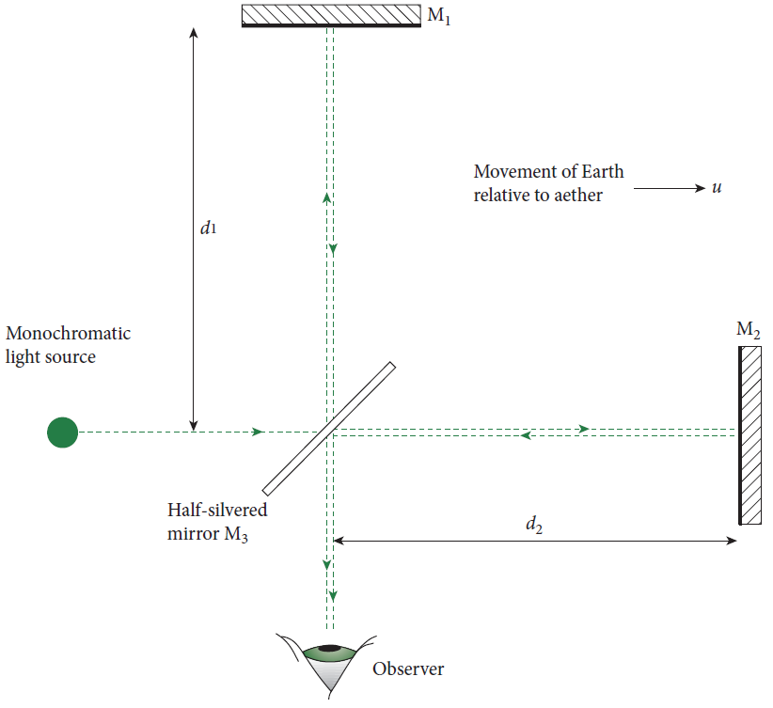
Finding the aether: the Michelson–Morley experiment
Experiment to find the aether
Mirror 1
Aether moves to right
Light travels to and from:
M1 across aether path
M2 along aether path
Mirror 2
Prediction
Path differences cause observable interference effect
Notes:
The Michelson–Morley experiment was designed to measure relative movement of light with respect to the aether. By analogy with a river, they lined up the equipment so that a light ray went up and back in the direction of the aether and, at the same time, went across the aether. Both rays were received at the same screen (observer).
Light acts as a wave, so any difference in time taken for the rays to traverse the different paths would show up a predictable change to the interference pattern.

Slide 11
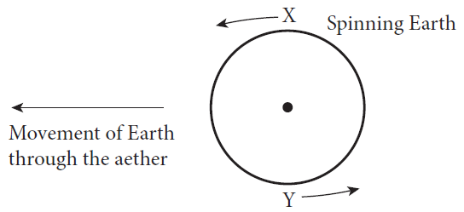
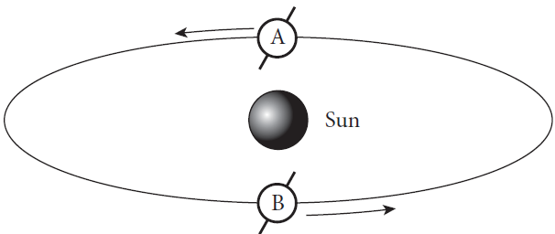
Michelson–Morley: Earth’s rotation and revolution
Comparing results with and against aether
Sequence 1: 12 hours apart
Earth’s rotation
Sequence 2: 6 months apart
Earth’s revolution
Notes:
The Michelson–Morley experiment was conducted over a 12-hour period, to use the speed of rotation of the Earth. The arm of the experiment parallel to the aether’s speed would be going with aether and, 12 hours later, against the aether.
Similarly, they did the experiment six months apart to take account of the Earth’s speed of revolution around the Sun.

Slide 12
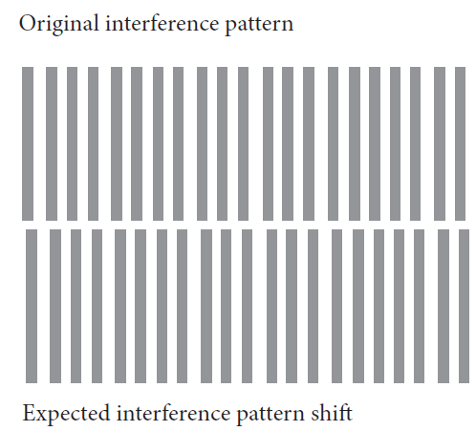
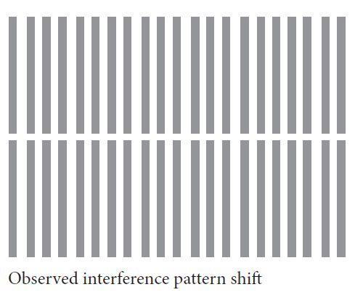
The most famous ‘Null result’
Expected pattern:
0.4 fringe shift
Observed pattern:
<0.1 fringe shift
Conclusion
The aether does not exist
Notes:
The Michelson–Morley experiment was done really accurately. They expected a 40% shift of the interference pattern. This would show up as a shift from normal of a bit less than half the width of an interference fringe.
What they saw was no greater shift than about 10%, all of which could be accounted for by uncertainties in measurement. The expected shift simply did not occur.
This is the ‘Null result’. The expected change did not occur. They concluded that the aether did not exist.

Slide 13
Chapter 6: Einstein’s special relativity
Einstein, Maxwell, space and time
Notes:
Maxwell’s unification of electricity and magnetism showed light to act as an electromagnetic wave. The wave speed was dependent on the material in which the light travelled, not the source or the relative motion of source and material.
This led Einstein to reconsider the assumptions about space and time underlying Newtonian models.

Slide 14
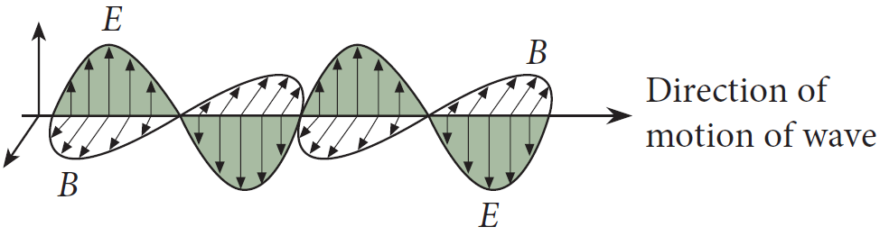
Einstein’s reflections on Maxwell’s equations
What would it look like to travel along with a light wave?
Time axis would stand still
Space axis would continue to change
BUT
How can space change without time passing?
Einstein’s insight
Look at assumptions about space and time
Notes:
Einstein noticed that, if you travelled with an electromagnetic wave, you would not be able to see time change. However, there was no impediment to seeing space variables change.
Thus, space could change without time changing. This seemed an impossibility. He realised that assumptions built into the way motion and its causes were understood needed to reconsidered.

Slide 15
Postulates of special relativity
Space and time reconsidered
First postulate:
special relativity postulate
The laws of physics are the same in all inertial frames of reference
Second postulate
The speed of light has the same value, c, in all inertial frames of reference
‘c’ does not depend on source speed or observer
Aether hypothesis is unnecessary
Notes:
Einstein put forward two postulates in his theory of special relativity, which related to all inertial reference frames:
(i) the laws of physics are the same (values for quantities might be different in different frames but the laws would still hold)
(ii) the speed of light is the same (it does not depend on source or motion of source).
He recognised that the aether, a transparent, massless, absolutely stationary medium that allowed electromagnetic oscillations to occur, was irrelevant to the analysis.

Slide 16
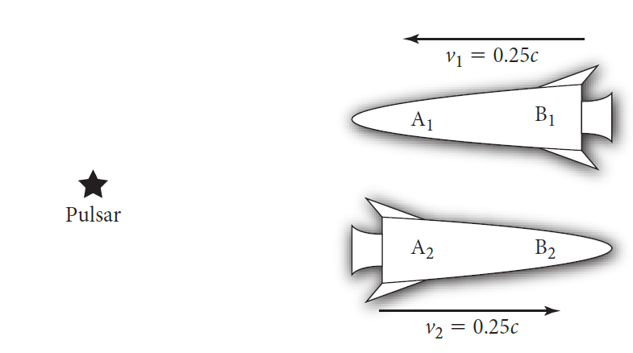
Einstein vs Newton
Two rockets travel in opposite directions
Both measure the speed of light from a pulsar
Light speed for
Rocket 1:
Rocket 2:
Light speed for
Rocket 1:
Rocket 2:
Newton
Einstein
Einstein is correct
Notes:
From Postulate 2, Einstein showed that the speed of a rocket towards or away from a light source does not depend on the relative motion of source and rocket. This is consistent with Maxwell’s unification of electric and magnetic field theory. Despite Rocket 1 travelling towards the light source, the speed of light is measured at 3.00 x 10⁸ m s^{–1}. Likewise, Rocket 2 travels away from the source but also measures the speed of light as 3.00 x 10⁸ m s^{–1}.
Newton’s ‘commonsense’ view of relative motion is incorrect.

Slide 17
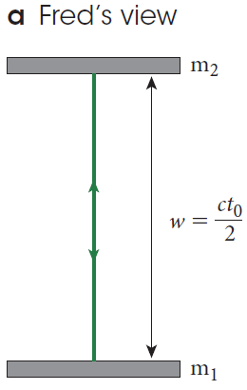
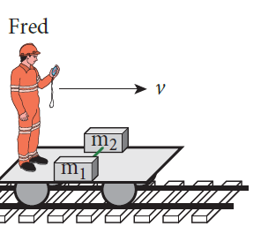
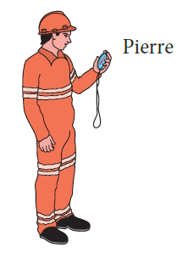
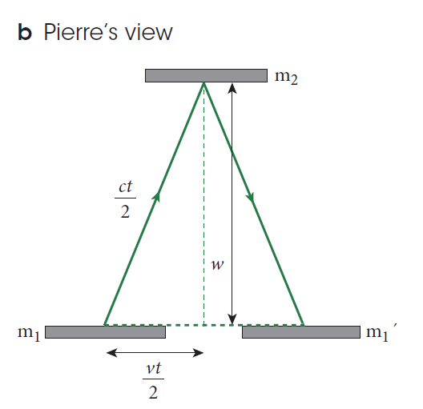
Proper and relativistically corrected time
Proper time:
Relativistically
corrected time:
Notes:
Light travels backwards and forwards between mirrors on Fred’s train. Fred travels with the train. He measures proper time, that is, time in the frame of the mirrors. Pierre measures time from a different inertial frame.
He sees light taking a different path, based on the movement of the mirrors while the light is going back and forth. His time is longer than the proper time. Time is dilated in Pierre’s frame of reference.

Slide 18
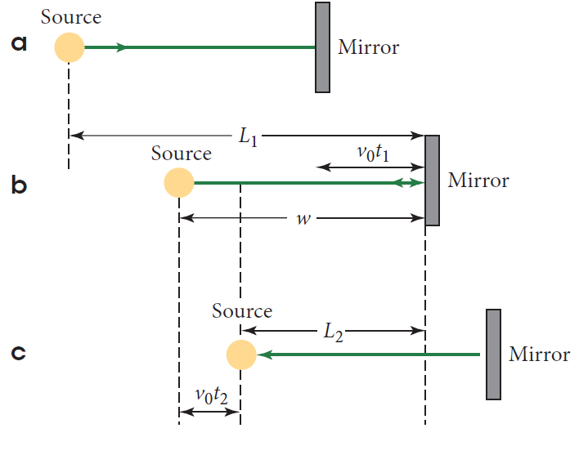
Length contraction
Proper length:
Relativistically corrected length:
Notes:
Light travels from source to mirror and back. Observer travelling with source and mirror measures proper length. Observer on ground watching as the source and mirror whiz past sees the outward light travel a further distance.
Homeward, the distance is shorter. Taking account of time, dilation sees the length appear shorter: length contraction.

Slide 19
Summary: Lorentz transformations
Lorentz factor:
Time dilation:
Length contraction:
Notes:
The Lorentz factor appears in time dilation and length contraction equations. Is there a physical change to clocks and lengths of objects (Fitzgerald/Lorentz) or do space and time change (Einstein)?

Slide 20
Chapter 6: Einstein’s special relativity
Evidence and thought experiments
Notes:
Evidence is specific data collected from observations and experiments. Thought experiments are constructed scenarios that elucidate the predictions of a theory.
Thought experiments need to be tested by observation and experiment.
Evidence for the validity of Einstein’s special theory of relativity came first in experiments with muons. The concept of simultaneity was first elucidated via thought, or gedanken experiments.

Slide 21
Experimental evidence for relativistic effects: muon decay #1
Frisch and Smith experiment
Muons collected 1907 m apart
Muon data:
In muon’s reference frame:
Time of flight:
Almost zero muons reach ground
In Earth’s reference frame:
Time of flight:
Many muons reach ground
Notes:
Frisch and Smith, and many others subsequently, measured a predicted effect of Einstein’s theory. Muons are produced in the upper atmosphere, travel at speeds near the speed of light and decay rapidly into something different.
Einstein predicts that, from the muon’s reference frame, 2.90 mean lifetimes would pass before the muons reached the ground. The mean lifetime is the time it would take, on average for all the muons to decay.
So, nearly 3 mean lifetimes suggests that almost no muons would reach the ground. On the other hand, from an observer on the Earth, only 0.29 mean lifetimes pass before the muons arrive.
This means that a significant number of muons would arrive at the surface before decaying.

Slide 22
Frisch & Wilson cont.
Frisch and Smith experiment
Upper collector: 563 muons per hour
Lower collector: 412 muons per hour
Prediction correct
Einsteinian special relativity works.
Time of flight between collectors:
Mean lifetime:
measure of probability of all decays occurring
Muon frame:
Earth frame:
Number of mean lifetimes
2.90
0.29
Notes:
Another way of looking at this is in terms of distance. In the Figure on the next slide, we see that, from the muon frame of reference, the probability of them all decaying means that, on average they will travel 656 m.
From an Earth-based observer, the muons would travel about 6 times the distance in Frisch and Smith’s experiment. Plenty of muons would be able to reach the Earth.
Distance and time predictions are consistent. From the reference frame of the muon, almost none reach Earth. From Earth’s reference frame, plenty of muons arrive.
At their Earth-based collector, Frisch and Smith recorded the expected, large number of muons. This is a clear demonstration of Einsteinian special relativity.

Slide 23
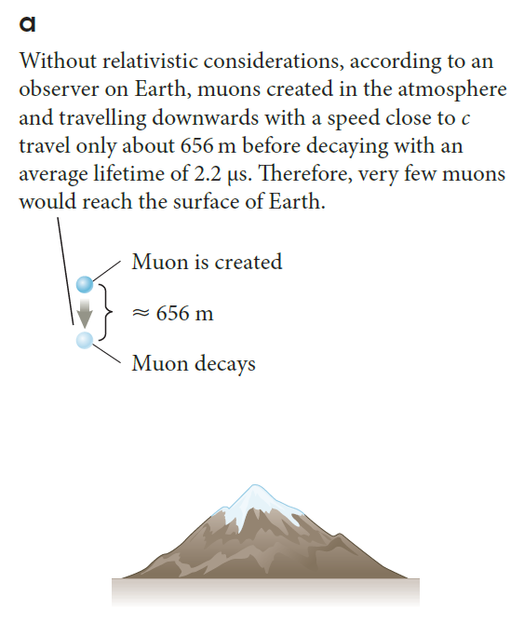
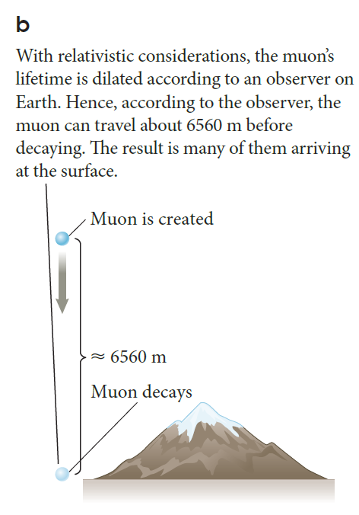

Slide 24
Agreement/disagreement in muon and Earth frames (Frisch and Wilson cont.)
Agreement in both muon and Earth frames:
Relative speed
Number of physical decays of muons
Number of elapsed mean lifetimes
Disagreement in muon and Earth frames:
Mean lifetime
Distance between collectors
=> muon numbers reaching ground
Notes:
The speed of the muon is the same in each reference frame. The number of decays is not dependent on the reference frame, which means the number of elapsed mean lifetimes is the same.
However, the mean lifetime is dependent on time, hence must be relativistically corrected, which means the length of the mean lifetime differs from frame to frame; likewise the distance.
Thus, the number of muons that reach the ground differs in each frame of reference.

Slide 25
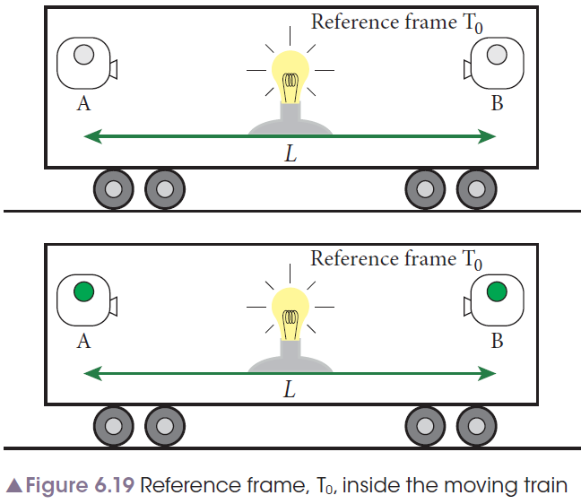
Simultaneity: in an inertial frame
A light is placed equidistant from two sensors
In reference frame, Tsub0
When light is turned on
A and B turn green
Simultaneously
Notes:
Simultaneous events occur at the same time in a particular reference frame. Travelling with the light source and detectors, you would see the detectors light up at the same time.
There is no relative motion between source, detectors and the observer. The collector events are simultaneous.
When the observer is in another inertial reference frame, the collector events are not simultaneous. The observer sees the left-hand collector moving towards the light as it comes towards it.
It turns on first, because the right-hand collector is seen by the observer going away from the light. It takes longer for the light to arrive.

Slide 26
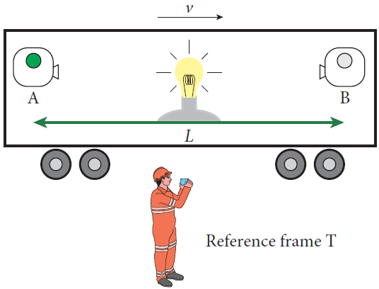
Simultaneity: watching from another inertial frame
A light is placed equidistant from two sensors
In reference frame, T
When light is turned on
First, A turns green
Then, B turns green
Events are not simultaneous

Slide 27
Simultaneity: Summary
Two events are simultaneous when
they occur at the same time
Simultaneous events in one inertial frame
may not be simultaneous
in another inertial frame of reference
Notes:
Simultaneous events occur at the same time.
Events that are simultaneous in one inertial reference frame are not necessarily simultaneous when viewed in another inertial reference frame.
Simultaneity is dependent on the observer’s frame of reference.

Slide 28
Chapter 6: Einstein’s special relativity
Einstein’s famous equation
Notes:
E = mc² is arguably the most famous formula in the world. But what does it mean? Essentially, it means that mass is a form of energy.
Mass is itself subject to relative motion. For rapidly moving matter, mass must be relativistically corrected.

Slide 29
Mass
Rest or proper mass:
Measured in stationary inertial frame
Never changes
Mass is
relativistically corrected
Notes:
Like proper time and proper distance, rest or proper mass is measured by an observer in a stationary frame of reference.
If the observer is in an inertial frame of reference that is moving relative to the mass, the mass must be relativistically corrected.

Slide 30
Momentum
Momentum is relativistically corrected
Notes:
Momentum must be relativistically corrected whenever the mass must be likewise corrected.

Slide 31
Einstein’s famous equation: E = mc²
Rest mass-energy:
Energy change:
Mass and energy are equivalent
Mass is a manifestation of energy
Notes:
Mass and energy are equivalent. This is bound up in the general equation, E = mc². Mass and energy are interchangeable.

Slide 32
Mass defect in nuclear physics
Mass appears as energy in nuclear events:
Radioactive decay
Nuclear reactions
Fission
Fusion
Mass defect
Difference between initial and final arrangement of particles.
Notes:
During nuclear events, particles are rearranged. The mass of products is less than that of the original particles. The loss is accounted for by the energy of the system. And that energy is consistent with predictions based on Einstein’s famous equation, E = mc². The mass defect is the mass or energy equivalent of the difference between initial and final arrangements of particles.

Slide 33
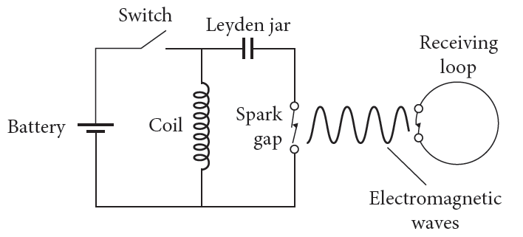
Units of mass
Mass units:
kilogram: kg
unified mass unit: u
electron-volt: eV, keV, MeV
Notes:
Units of mass may be kilograms, unified mass units and electron-volt (or multiples thereof). The electron-volt represents the energy equivalent of mass. In nuclear and particle physics, the use of energy units for mass is common.

